Slide 1

DEPI Final Project
Under supervising of Dr. Rehab Mostafa

Slide 2


Our Team
Marwan Hesham
Mohamed Ibrahim
Ahmed Magdy
Bassel Adnan
Moamen Mohamed

Slide 3

Network Infrastructure for Startups: Design, Configuration, and Implementation
This presentation covers our network project for a startup company.
We explore three main phases: design, configuration and implementation, and testing.
Our goal: build a reliable, scalable, and secure network foundation.

Slide 4
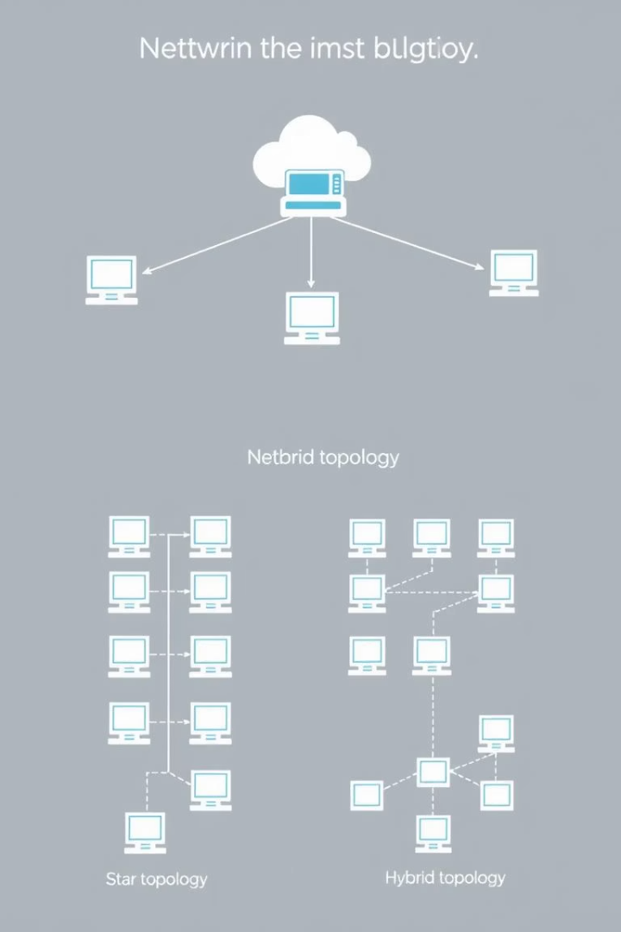
Phase 1: Network Design
Needs Assessment
Identify users, devices, and applications to support growth.
Topology Selection
Choose star topology for simplicity and ease of troubleshooting.
IP Addressing
Implement subnetting, e.g., 192.168.10.0/24 for organized addressing.
Security Planning
Integrate firewall and access controls from the start.

Slide 5





Departments and Distribution
HR
Development
Sales
Marketing
5 Devices Vlan 10 192.168.10.0/24 192.168.10.1
10 Devices Vlan 20 192.168.20.0/24 192.168.20.1
10 Devices Vlan 30 192.168.30.0/24 192.168.30.1
10 Devices Vlan 40
192.168.40.0/24
192.168.40.1

Slide 6

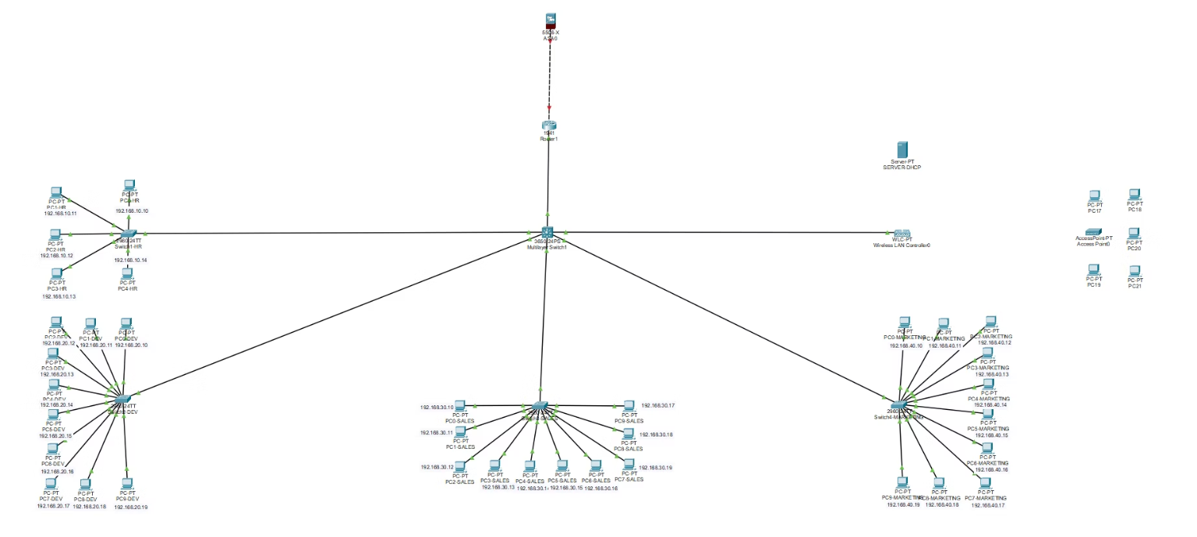
Network Topology

Slide 7

Phase 2: Network Configuration
1
Device Configuration
configure the network devices according to the designed topology
2
Network Services
Set up essential network services like DHCP, DNS, and NAT.
3
Security Configuration
Implement the designed security measures, including firewall rules, VPN configuration, and ACLs

Slide 8

Phase 3: Testing and Optimization
Connectivity Testing
Performance Testing
Security Testing
Optimization
Run vulnerability scans to detect weaknesses.
Refine configuration based on test data.
Use ping and traceroute to verify network paths.
Measure bandwidth and latency to ensure speed.

Slide 9







Used testing commands
Ping
Traceroute
show vlan brief
show mac-address table
Reply from host = good connectivity
Shows each hop (router) the packet passes through
Verifies VLAN configurations
Check which mac-addresses are learned on which port
Helps identify where connectivity breaks down
show interface trunk
show cdp neighbors
show running-config
checks trunk port status
Lists directly connected cisco devices
views current switch configuration

Slide 10

Conclusion and Next Steps
Summary
Importance
Q&A
Complete network design, configuration, implementation, and testing phases.
Network foundation is critical for startup success and growth.
Open floor for questions and further discussion.

